Slide 1
-
阅读论文，准备报告
1.《动态 Web应用中的缺陷定位研究》—— WDL方法
2.《一种基于遗传算法的多缺陷定位方法》—— GAMFal方法
3.《MSFL: A Model for Fault Localization Using Mutation-Spectra Technique》——将mutation和spectrum结合
4.《A Hybrid Approach to Fine-grained Automated Fault Localization》—— 提出了一种基于动态谱和静态谱的混合细粒度AFL方法。
5.《Enhancing Spectrum-Based Fault Localization Using Fault Influence Propagation》——集成了基于频谱的故障定位和故障影响传播分析
延时符

Slide 2

A Hybrid Approach to Fine-grained Automated Fault Localization
作者：Leping Li、Hui Liu
汇报人：陈冰婷
导师：邹卫琴
延时符

Slide 3
PART 01
Why use HybridAFL?
目录
Contents
PART 02
What is HybridAFL?
PART 03
How does it perform?
延时符

Slide 4



Why
Why use HybridAFL?
Challenging
Tedious
Time-consuming
Automated
Simple
Intuitive
延时符

Slide 5
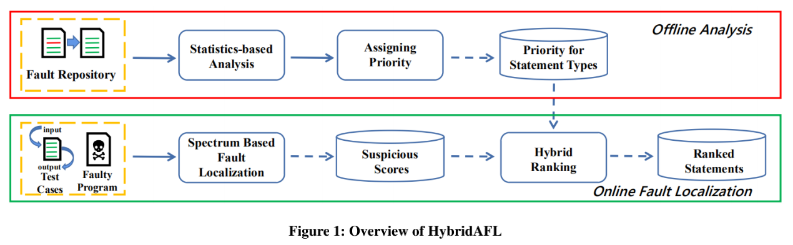
What
What is HybridAFL?
Rationale: Some types of statements are significantly more/less error-prone than others, and thus statement types could be exploited for fault localization.
延时符

Slide 6
What
What is HybridAFL?
HybridAFL applies statistics analysis to a fault repository to compute the error-proneness for each of the statement types involved in the repository.
Based on the resulting error-proneness, HybridAFL identifies special statement types that are steadily more/less error-prone than others.
HybridAFL assigns priorities to special statement types selected in the preceding step. The more error-prone a statement type is,the greater priority it receives.
延时符

Slide 7
What
What is HybridAFL?
For a faulty program to be debugged, HybridAFL collects suspicious statements from the faulty program and computes their suspicious scores by traditional SBFL.
HybridAFL adjusts the suspicious scores according to statement types, i.e., multiplying the SBFL suspicious scores by the priorities assigned to the statement types.
All of the suspicious statements are ranked by the updated suspicious scores in descending order. Statements on the top are more likely to be faulty and thus should be inspected first.
延时符

Slide 8
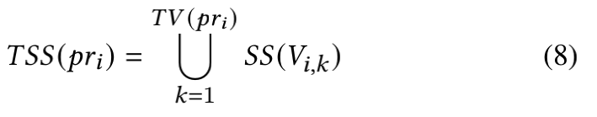
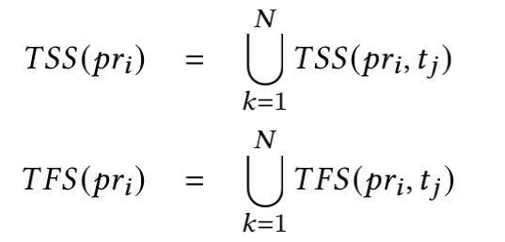
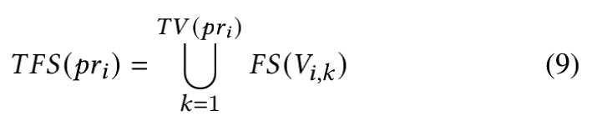
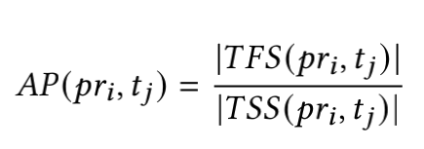
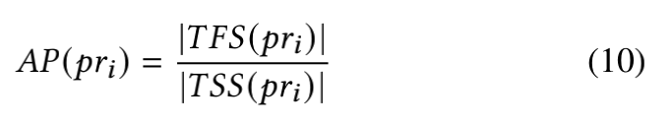
How
2.1 Statistics-based Analysis on Fault Repositories
Key Rational： Different types of statements are not equally error-prone.
延时符

Slide 9

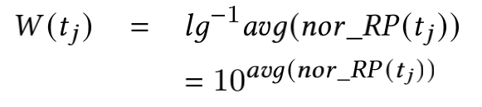
How
2.2 Assigning Priorities to Special Statements
Key Rational： Some types of suspicious statements are significantly more/less error-prone than others.
1)
2)
3)
延时符

Slide 10

How
2.3 Hybrid Ranking
Key Rational： Different typesof statements are not equally error-prone.
延时符

Slide 11
Evaluation
How
RQ01 | Are different types of statements equally error-prone?
RQ02 | Does the proposed approach outperform the state-of-the-art fine-grained fault localization techniques?
RQ03 | How does the performance of the proposed approach varyin locating different types of faulty statements?
RQ04 | Can we further improve the proposed approach by assigning priorities to all statements besides the special statementsselected in Section 3.3?
RQ05 | Can we further improve the proposed approach by leveraging the median instead of the average in Formula 17?
RQ06 | Should we apply multi-level sorting to fault localization byleveraging both SBFL scores and priorities of statement types?
RQ07 | Can we improve other SBFL algorithms in the same wayas we improve 𝑂𝑐ℎ𝑖𝑎𝑖?
延时符

Slide 12
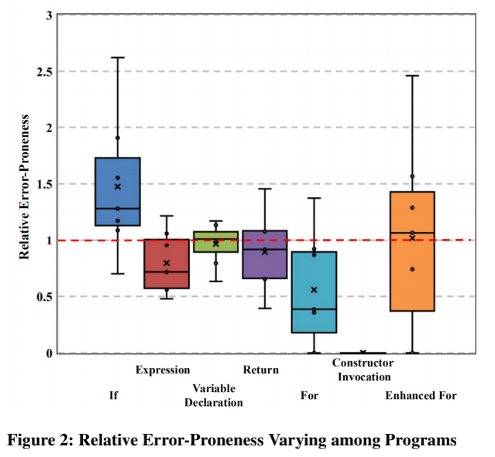
How
RQ1: Some Types of Statements are Significantly More Error-Prone Than Others
延时符

Slide 13
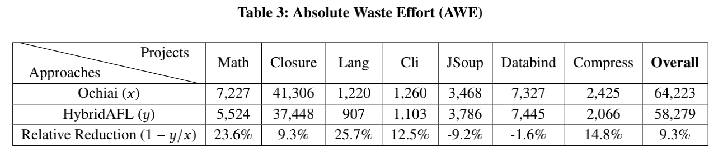
How
RQ2: HybridAFL Improves the State of the Art
延时符

Slide 14
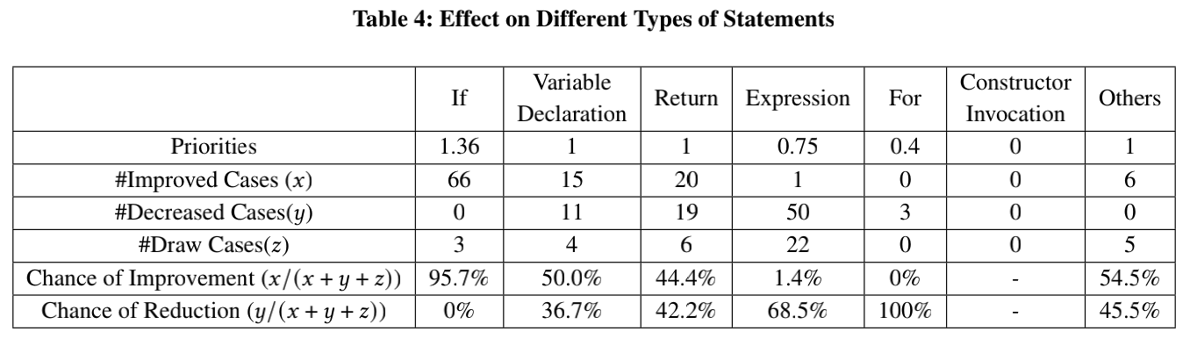
How
RQ3: Good at Locating High-Priority Statements
延时符

Slide 15
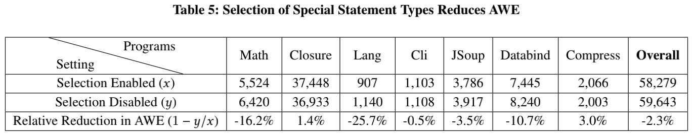
How
RQ4: Selection of Special Statement Types
延时符

Slide 16
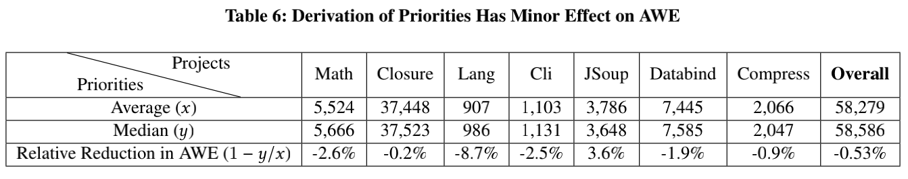
How
RQ5: Average VS. Median
延时符

Slide 17
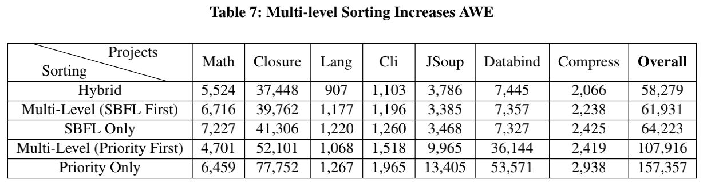
How
RQ6: Multi-level Sorting Does Not Work
延时符

Slide 18
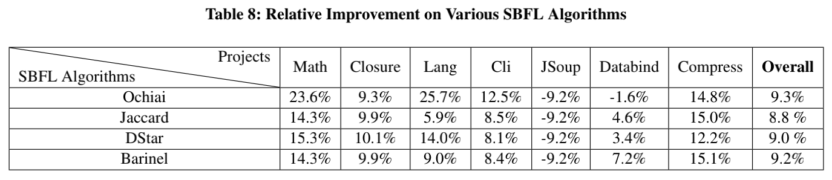
How
RQ7: Improving Various SBFL Algorithms
延时符

Slide 19
THANK YOU FOR YOUR LISTENING.
谢谢您的聆听

